Slide 1
Data Structures and Algorithms (ESO207)
Lecture 38
An interesting problem:
shortest path from a source to destination

Slide 2
Shortest pathS in a graph
A fundamental problem

Slide 3


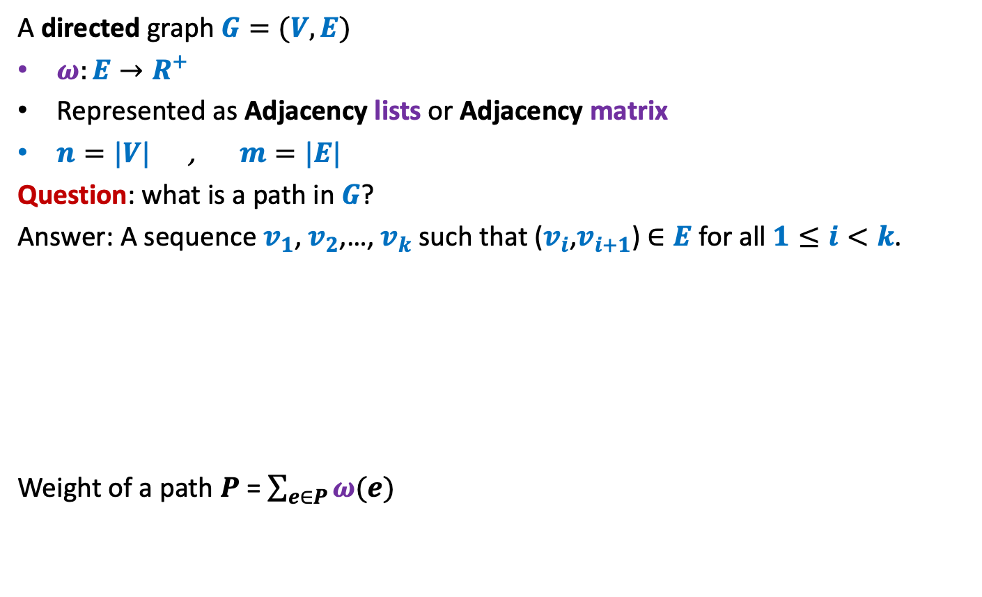



Notations and Terminologies
A directed graph $G=(V,E)$
$ω:E→R^{+}$
Represented as Adjacency lists or Adjacency matrix
$n=|V|$ , $m=|E|$
Question: what is a path in $G$?
Answer: A sequence $v_{1}$, $v_{2}$,…, $v_{k}$ such that ($v_{i}$,$v_{i+1}$) $∈E$ for all $1≤i<k$.
Weight of a path $P$ = $\sum_{e∈P}{ω(e)}$
12
3
…
29
$$v_{1}$$
$$v_{2}$$
$$v_{3}$$
$$v_{k−1}$$
$$v_{k}$$

Slide 4

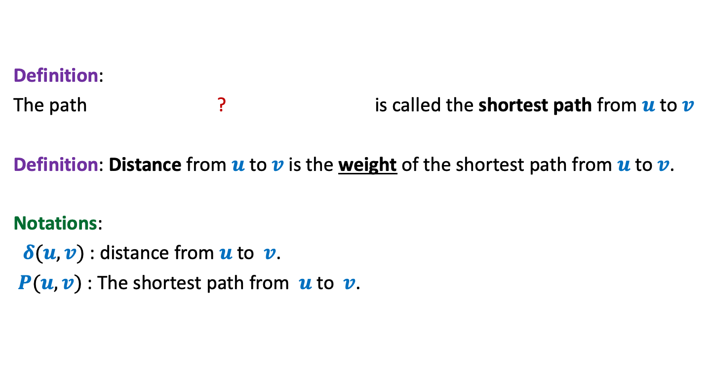
Notations and Terminologies
Definition:
The path ? is called the shortest path from $u$ to $v$
Definition: Distance from $u$ to $v$is the weight of the shortest path from $u$ to $v$.
Notations:
$δ(u,v)$ : distance from $u$to $v$.
$P(u,v)$ : The shortest path from $u$to $v$.
from $u$ to $v$of minimum weight

Slide 5



Problem Definition
Input: A directed graph $G=(V,E)$ with $ω:E→R^{+}$ and a source vertex $s∈V$
Aim:
Compute $δ(s,v)$ for all $v∈V\backslash \{s\}$
Compute $P(s,v)$ for all $v∈V\backslash \{s\}$
What if $ω(e)$ = 1 ?
Do BFS from $s$
☺

Slide 6
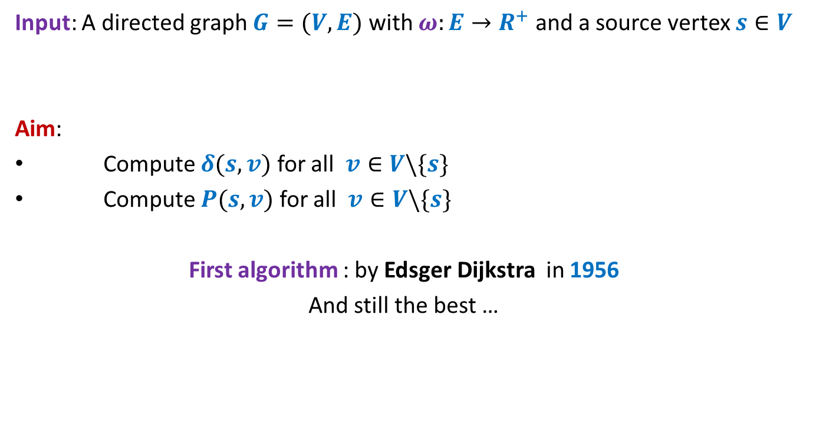
Problem Definition
Input: A directed graph $G=(V,E)$ with $ω:E→R^{+}$ and a source vertex $s∈V$
Aim:
Compute $δ(s,v)$ for all $v∈V\backslash \{s\}$
Compute $P(s,v)$ for all $v∈V\backslash \{s\}$
First algorithm : by Edsger Dijkstra in 1956
And still the best …
I am sure you will be able to re-invent it yourself if you are asked right questions ☺ So get ready !

Slide 7
An example to get an insight into this problem
Inference:
The distance to any vertex depends upon global parameters.
$$q$$
5
7
6
12
G
$$s$$
16
4
9
11

Slide 8
An example to get an insight into this problem
Question: Is there any vertex in this picture for which you are certain about the distance from $s$ ?
Answer: vertex $u$.
$$z$$
10
$$v$$
G
12
7
$$x$$
$$s$$
3
5
$$u$$
$$y$$
Give reasons.

Slide 9
An example to get an insight into this problem
➔ The shortest path to vertex $u$ is edge ($s$,$u$).
$$z$$
10
$$v$$
G
12
7
$$x$$
$$s$$
3
5
$$u$$
$$y$$
$$>0$$

Slide 10
Designing a greedy algorithm for shortest paths
Establish a relation between shortest paths in $G$
and
shortest paths in $G′$
$$G$$
instance of size $n$
Greedy
step
$$G′$$
instance of size $<n$

Slide 11
An example to get an insight into this problem
Question: Can you remove vertex $u$ without affecting the distance from $s$ ?
$$z$$
10
$$v$$
G
12
7
2
$$x$$
$$s$$
21
$$t$$
3
5
$$u$$
3
8
$$y$$
$$r$$

Slide 12
An example to get an insight into this problem
$$z$$
10
$$v$$
12
7
+3
G’
2
+3
$$x$$
21
$$t$$
$$s$$
5
+3
+3
8
3
$$y$$
$$r$$

Slide 13
An example to get an insight into this problem
$$z$$
10
$$v$$
G’
12
7
5
$$x$$
24
$$t$$
$$s$$
5
6
11
$$y$$
$$r$$

Slide 14
How to compute instance $G′$
Let ($s$,$u$) be the least weight edge from $s$ in $G$=($V$, $E$).
Transform $G$ into $G′$ as follows.
1. For each edge ($u$,$x$)ϵ $E$,
add edge ($s$,$x$);
$ω$($s$,$x$)← ??
2. In case of two edges from $s$ to any vertex $x$ , keep only the lighter edge.
3. Remove vertex $u$.
Theorem: For each $v∈V\backslash \{s,u\}$,
$$δ_{G}\left(s,v\right)=δ_{G^{′}}\left(s,v\right)$$
an algorithm for distances from $s$with $O(n^{2})$ time complexity.
$ω$($s$,$u$) + $ω$($u$,$x$);
Can you see some negative points of this algorithm ?

Slide 15
Shortcomings of the algorithm
No insight into the (beautiful) structure of shortest paths.
Just convinces that we can solve the shortest paths problem in polynomial time.
Very few options to improve the time complexity.
We shall now design a very insightful algorithm based on properties of shortest paths.

Slide 16
Property of a shortest path

Slide 17
Optimal subpath property
Consider any shortest path $P(s,v)$.
$δ(s,v)$= 51
Lemma 1: Every subpath of a shortest path is also a shortest path.
NOTE: Does the lemma use the fact that the edge weights are positive?
If yes, can you locate the exact place where it used it?
Anyway, give a proof of the lemma
< 27
12
3
7
5
15
9
$$s$$
$$a$$
$$g$$
$$y$$
$$u$$
$$x$$
$v$
Can you realize an assumption in your proof ?
?
Homework: Write a complete and formal proof for Lemma 1

Slide 18
Exploiting the positive weight on edges
Consider once again a shortest path $P(s,v)$.
➔ $δ\left(s,a\right)<δ\left(s,g\right)<δ\left(s,y\right)<δ\left(s,u\right)<δ(s,x)<δ(s,v)$
The first nearest vertex of $s$ must be its neighbor.
$$>0$$
$$>0$$
$$>0$$
$$>0$$
$$>0$$
$$>0$$
$$s$$
$$a$$
$$g$$
$$y$$
$$u$$
$$x$$
$v$
(1)

Slide 19
More insights …
What can we say about $x$ ?
Let $s_{i}$ : $i$th nearest vertex from $s$.
$s_{0}$ = $s$.
Consider the shortest path $P\left(s,s_{i}\right)$.
Lemma 2: $P\left(s,s_{i}\right)$ must be of the form $s ⇝$ $s_{j} →s_{i}$ for some $j<i$.
$x$ must be $s_{j}$ for some $j<i$.
$$s$$
$$x$$
$s_{i}$
What picture captures all shortest paths from $s$?

Slide 20
Complete picture of all shortest paths ?
Shortest paths tree
$$s$$
$$s_{4}$$
$$s_{1}$$
$$s_{7}$$
$$s_{5}$$
$$s_{2}$$
$$s_{3}$$
$$s_{6}$$

Slide 21
Designing the algorithm …
Lemma 2: $P\left(s,s_{i}\right)$ must be of the form $s ⇝$ $s_{j} →s_{i}$ for some $j<i$.
Question: Can we use Lemma 2 to design an algorithm ?
Incremental way to compute shortest paths.
Ponder over it before going to the next slide ☺
shortest

Slide 22
Designing the algorithm …
Lemma 2: $P\left(s,s_{i}\right)$ must be of the form $s ⇝$ $s_{j} →s_{i}$ for some $j<i$.
Question: Can we use Lemma 2 to design an algorithm ?
Incremental way to compute shortest paths.
If shortest paths to $s_{j}$, $j<i$ is known, we can compute $s_{i}$.
But how ?
All we know is that $s_{i}$ is neighbor of $s_{j}$ for some $j<i$.
But which neighbor ?
shortest
The next slide explains it precisely.
Hint:
For each neighbor, compute some label based on Lemma 2 s.t. $s_{i}$ is the neighbour with least label.

Slide 23
Suppose we have computed $s_{1}$, $s_{2}$,…, $s_{i−1}$.
We can compute $s_{i}$ as follows.
For each $v∈V \backslash \{s_{1}\text{,} s_{2}\text{,…,} s_{i−1}\}$
$$L\left(v\right)=$$
$s_{i}$ is ??
$$s$$
G
$$s_{1}$$
$$s_{4}$$
$$v$$
$$s_{2}$$
$$s_{3}$$
$$\left(δ\left(s,s_{j}\right)+ω\left(s_{j},v\right)\right)$$
$$\min_{\left({(s}_{j},v\right)∈E)}{ ? }$$
the vertex with minimum value of $L$.

Slide 24
Dijkstra’s algorithm
Dijkstra-algo($s$,$G$)
{ $U$ ← $V \backslash \left\{s\right\}$;
$S$← $\left\{s\right\}$;
For $i$ = 1 to $n−1$ do
{ For each $v∈U$ do
{ $L\left(v\right)$← $∞$;
For each $(x,v)∈E$ with $x∈S$do
$L\left(v\right) \text{←}$ min( $L\left(v\right)$, $δ\left(s,x\right)+ω\left(x,v\right)$ )
}
$y$← vertex from $U$ with minimum value of $L$;
$δ\left(s,y\right)\text{←}L\left(y\right)$;
move $y$ from $U$ to $S$;
}

Slide 25
In this algorithm, we first compute $L(v)$ for each $v∈U$ and then find the vertex with the least $L$value.
Try to rearrange its statements so that in the beginning of each iteration, we have $L$ values computed already.
This rearrangement will be helpful for improving the running time.
So please try it on your own first before viewing the next slide.

Slide 26
Dijkstra’s algorithm
Dijkstra-algo($s$,$G$)
{ $U$ ← $V$;
$L\left(s\right)$← $0$;
For $i$ = 0 to $n−1$ do
{ $y$← vertex from $U$ with minimum value of $L$;
$δ\left(s,y\right)\text{←}L\left(y\right)$;
move $y$ from $U$ to $S$;
For each $v∈U$ do
{ $L\left(v\right)$← $∞$;
For each $(x,v)∈E$ with $x∈S$do
$L\left(v\right) \text{←}$ min( $L\left(v\right)$, $δ\left(s,x\right)+ω\left(x,v\right)$ )
}
}
$L\left(v\right)$← $∞$ for all $v∈U$ ;
a lot of re-computation

Slide 27
Dijkstra’s algorithm
Dijkstra-algo($s$,$G$)
{ $U$ ← $V$;
$L\left(s\right)$← $0$;
For $i$ = 0 to $n−1$ do
{ $y$← vertex from $U$ with minimum value of $L$;
$δ\left(s,y\right)\text{←}L\left(y\right)$;
move $y$ from $U$ to $S$;
For each $v∈U$ do
{
For each $(x,v)∈E$ with $x∈S$do
$L\left(v\right) \text{←}$ min( $L\left(v\right)$, $δ\left(s,x\right)+ω\left(x,v\right)$ )
}
}
Only neighbors of $y$
$L\left(v\right)$← $∞$ for all $v∈U$ ;
What are the vertices
whose $L$ value may change
in this iteration ?

Slide 28
Dijkstra’s algorithm
Dijkstra-algo($s$,$G$)
{ $U$ ← $V$;
$L\left(s\right)$← $0$;
For $i$ = 0 to $n−1$ do
{ $y$← vertex from $U$ with minimum value of $L$;
$δ\left(s,y\right)\text{←}L\left(y\right)$;
move $y$ from $U$ to $S$;
For each $(y,v)∈E$ with $v∈U$do
{
$L\left(v\right) \text{←}$ min( $L\left(v\right)$, $δ\left(s,y\right)+ω\left(y,v\right)$ )
}
}
$L\left(v\right)$← $∞$ for all $v∈U$ ;
1 extract-min operation
deg($y$) Decrease-key operations

Slide 29
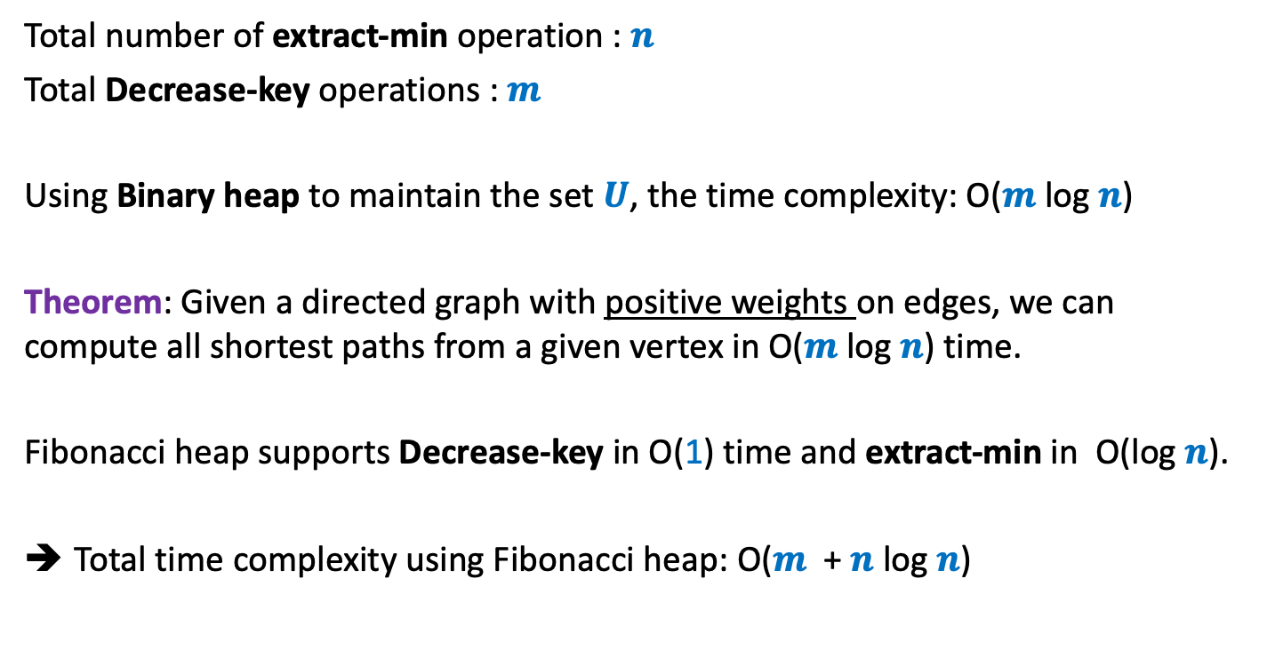
Time complexity of Dijkstra’s algorithm
Total number of extract-min operation : $n$
Total Decrease-key operations : $m$
Using Binary heap to maintain the set $U$, the time complexity: O($m$ log $n$)
Theorem: Given a directed graph with positive weights on edges, we can compute all shortest paths from a given vertex in O($m$log $n$) time.
Fibonacci heap supports Decrease-key in O(1) time and extract-min in O(log $n$).
Total time complexity using Fibonacci heap: O($m$ + $n$log $n$)

